Slide 1
PROJECT 3: PRESTIGE CARS
Group 4: Fahim Tanvir, Sayantan Saha, Yousef Ahmed, Esfar Rakin, Justin Zara

Slide 2

Introduction:
SQL naturally uses True, False, and Unknown (NULL).
.
NULLs cause ambiguous query results.
They break logical comparisons (Lets say NULL = NULL is not True).
They can be unpredictable and non-deterministic. Not great for consistency
Our goal is to reorganize Prestige Cars, which isn’t organized great to begin with and has a lot of NULL within the database. It needs to be more efficient so we can ensure data reliability and data governance. This is especially needed as many improving sales data and auditing for something like buying a car is needed to make sure transactions and sales are kept in order and on time.

Slide 3
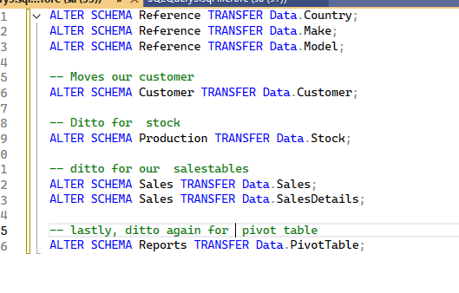
PART 1: Reorganize our tables
It is best to move around our
tables to a more fitting schema.

Slide 4
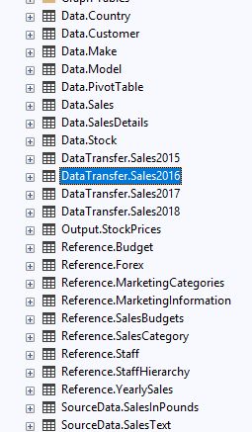
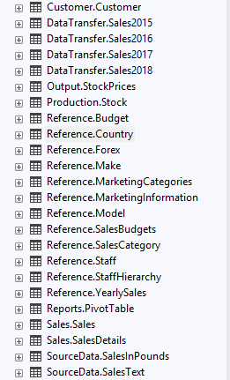
PART 1: Reorganize our tables
Putting our old tables into new schemas(Reference, Customer, Production, Sales, Reports), allows for better organization and practicality. If everything is in one place, it's hard to find what you need, and mistakes in one area could accidentally affect another table with a foreign key. By creating separations like this, you make the database easier to understand, manage, and secure.
BEFORE AFTER

Slide 5
Part 2:Constraints
We implemented constraints to replace problematic inputs such as NULL and maintain proper and well regulated practices for our db. They are set we don’t have anything, invalid, inconsistent or anything repeated in our database, so everything runs smoothly.
The Gatekeepers
Result: It is impossible for a row to physically exist with an invalid format.

Slide 6
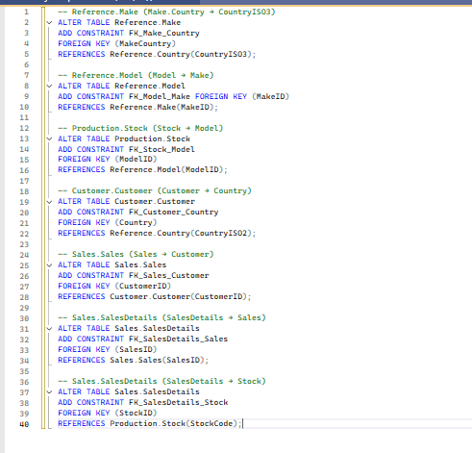
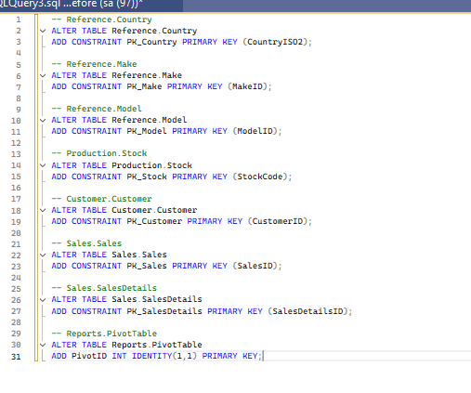
Part 2a:Constraints for our PK and FK
Here we will take our Primary keys and foreign keys and simply add constraints to establish our relationships with out tables.
The Gatekeepers
PRIMARY KEY(PK)
FOREIGN KEY(FK)
Result: It is impossible for a row to physically exist with an invalid format.

Slide 7
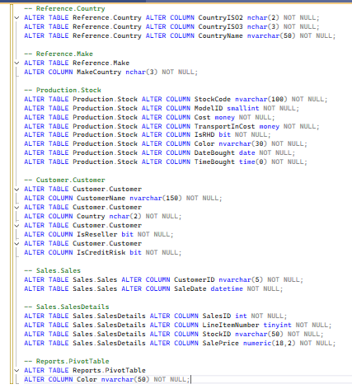
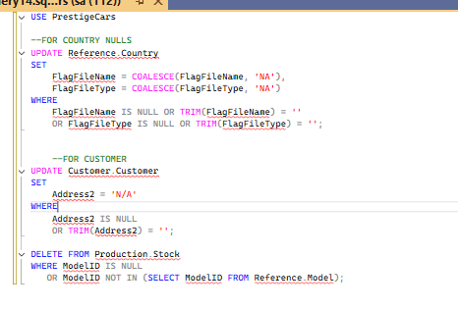
Part 2b: Null Constraints
Then our Null(Not Null in this case)Constraint
First let's get rid of some of our nulls
The Gatekeepers
Result: It is impossible for a row to physically exist with an invalid format.

Slide 8
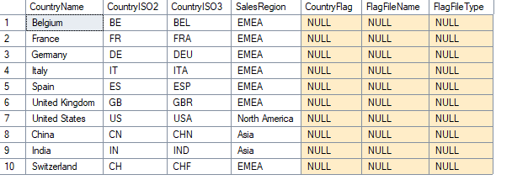
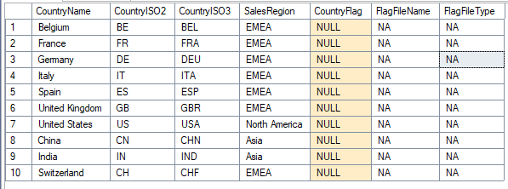
Part 2b: Null Constraints
BEFORE
AFTER
Our two modifications removes some of the NULLS and simply modifies the flag attributes so they aren’t labeled as all null. It is better to reduce the amount of them for better governance as nulls can be tricky due to being non-deterministic.
We implemented this for customers and country table.
The Gatekeepers
Result: It is impossible for a row to physically exist with an invalid format.

Slide 9
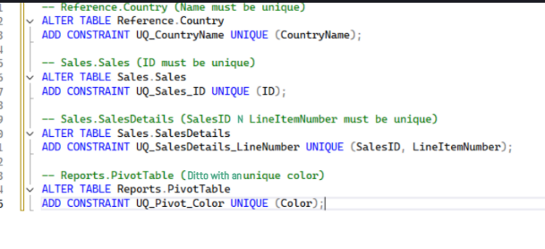
Part 2c: Unique Constraints
Unique Constraint UNIQUE constraints added
CountryName is unique
SalesID is unique
(SalesID, LineItemNumber) is unique
Color is unique
Result: It is impossible for a row to physically exist with an invalid format.

Slide 10
Part 2c: Unique Constraints
Reference.Country
------------------------------------
CountryISO3 CountryName
------------ ----------------------
USA United States
USA United States -- duplicate
DEU Germany
FRA France
DEU Germany -- duplicate
Reference.Country
---------------------------------------------------------
| CountryISO2 | CountryISO3 | CountryName | SalesRegion |
---------------------------------------------------------
| DE | DEU | Germany | EMEA
| FR | FRA | France | EMEA
| IT | ITA | Italy | EMEA
| ES | ESP | Spain | EMEA
| US | USA | United States | AMER
BEFORE
AFTER
Result: It is impossible for a row to physically exist with an invalid format.

Slide 11
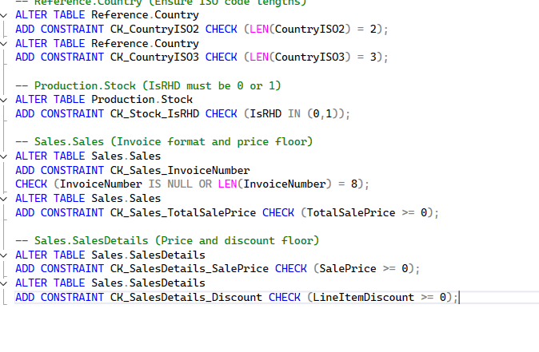
Part 2d: Check Constraints
Check Constraint is to enforce domain integrity by defining specific conditions that data must satisfy before it can be entered into a column. It's the most flexible constraint because you can use it to create almost any logical rule for whatever the care salesman needs.
Prevent bad values from entering the table
Enforce business rules automatically
Protect the table from incorrect data (negative prices, wrong formats, invalid codes, etc.)
Result: It is impossible for a row to physically exist with an invalid format.

Slide 12
Part 2d: Check Constraints
CountryISO2 NCHAR(2) NULL
CountryISO3 NCHAR(3) NULL
CountryName NVARCHAR(50) NULL
SalesRegion NVARCHAR(10) NULL
CountryISO2 NCHAR(2) NOT NULL CHECK (LEN(CountryISO2) = 2)
CountryISO3 NCHAR(3) NOT NULL CHECK (LEN(CountryISO3) = 3)
CountryName NVARCHAR(50) NOT NULL
BEFORE
AFTER
Result: It is impossible for a row to physically exist with an invalid format.

Slide 13
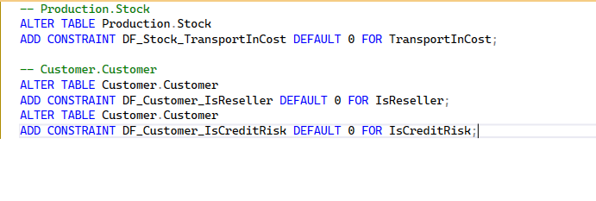
Part 2e: Defaults
DEFAULT CONSTRAINTS It assigns automatic, sensible values to certain fields if a user or program forgets to provide them during data entry.
The Gatekeepers
Result: It is impossible for a row to physically exist with an invalid format.

Slide 14
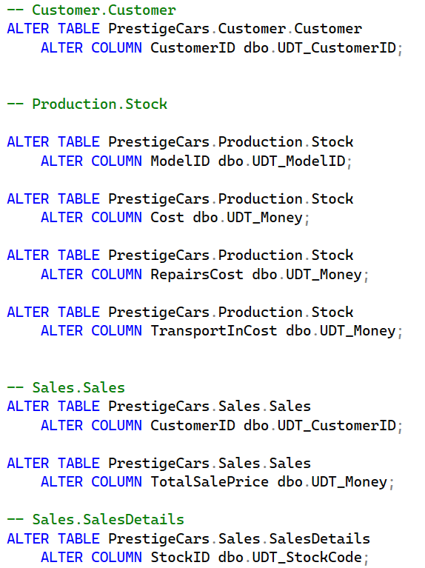
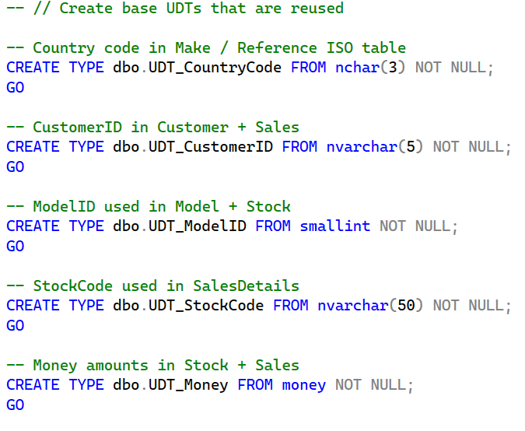
PART 3 UDT
A user defined data type (UDT) can be created to help standardize columns for multiple tables. They also maintain data integrity if business requirements change. UDTs also have the benefit of preventing invalid data that does not match the type, or null data from being entered in the future.
We can first define these UDTs then apply them to columns as needed.

Slide 15
PART 3a: Choosing Data Types
UDT_CountryCode FROM nchar(3) NOT NULL
ISO-3166 country codes are always 3 characters (e.g., USA, GBR, FRA).
nchar(3) limits each entry to 3 characters
NOT NULL prevents null entries
dbo.UDT_CustomerID FROM nvarchar(5) NOT NULL
Each CustomerID has leading 0s for a length of 4 characters (e.g. 0001, 0087, 0020)
nvarchar(5) can allow for customer ids > 9999
CREATE TYPE dbo.UDT_ModelID FROM smallint NOT NULL
smallint is any integer from 0–32,767
CREATE TYPE dbo.UDT_StockCode FROM nvarchar(50) NOT NULL
There can be any number of orders, so nvarchar has a high limit
CREATE TYPE dbo.UDT_Money FROM money NOT NULL;
money is a data type present in SQL server. It has fixed precision of four decimal places.

Slide 16
PART 3b: Cross System Compatibility
SQL Server | PostgreSQL | Oracle SQL
CREATE TYPE dbo.UDT_CountryCode FROM nchar(3) NOT NULL; | CREATE DOMAIN UDT_CountryCode AS char(3) NOT NULL; | CREATE OR REPLACE SUBTYPE UDT_CountryCode IS CHAR(3);
CREATE TYPE dbo.UDT_CustomerID FROM nvarchar(5) NOT NULL; | CREATE DOMAIN UDT_CustomerID AS varchar(5) NOT NULL; | CREATE OR REPLACE SUBTYPE UDT_CustomerID IS VARCHAR2(5);
CREATE TYPE dbo.UDT_ModelID FROM smallint NOT NULL; | CREATE DOMAIN UDT_ModelID AS smallint NOT NULL; | CREATE OR REPLACE SUBTYPE UDT_ModelID IS NUMBER(5);
CREATE TYPE dbo.UDT_StockCode FROM nvarchar(50) NOT NULL; | CREATE DOMAIN UDT_StockCode AS varchar(50) NOT NULL; | CREATE OR REPLACE SUBTYPE UDT_StockCode IS VARCHAR2(50);
CREATE TYPE dbo.UDT_Money FROM money NOT NULL; | CREATE DOMAIN UDT_Money AS numeric(19,4) NOT NULL; | CREATE OR REPLACE SUBTYPE UDT_Money IS NUMBER(19,4);
PostgreSQL does not have a built in UDT function. A workaround is to use a domain which allows for reusable datatypes within a table. Oracle represents UDTs as a Subtype object, but a NOT NULL constraint is not allowed on a subtype. It must be done on a per table basis.
- nchar/nvarchar is represented as char/varchar in PostgreSQL and Oracle.
- money is not a valid type in PostgreSQL and oracle. We can use a numeric (PostgreSQL) or number (Oracle) function that limits a decimal to 4 places to achieve the same function as money.

Slide 17
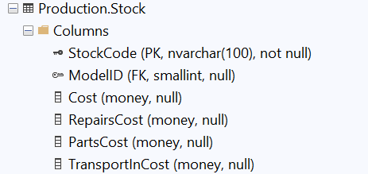
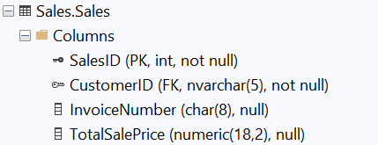
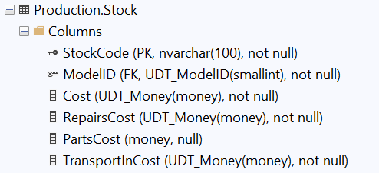
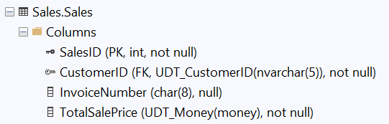
PART 3c: UDT Comparisons
BEFORE
AFTER

Slide 18
PART 4 ENTITY RELATIONAL DATA MODELING
Entity–Relationship Diagrams (ERDs) are visual models that show how tables in a database relate to one another.
They represent:
Entities (tables)
Attributes (columns)
Relationships (Primary/Foreign Key connections)
ERDs make it easy to understand how data flows across schemas and how business rules are enforced through constraints.
This ERD was automatically generated in SQL Server Management Studio (SSMS) to reflect the final structure of our PrestigeCars database after schema migrations, UDTs, and constraints were applied.
ELT Layer (Extract → Load → Transform)
In this project, all data was first loaded into SQL Server (“Load”), and then cleaned, structured, and governed directly inside the database (“Transform”).

Slide 19
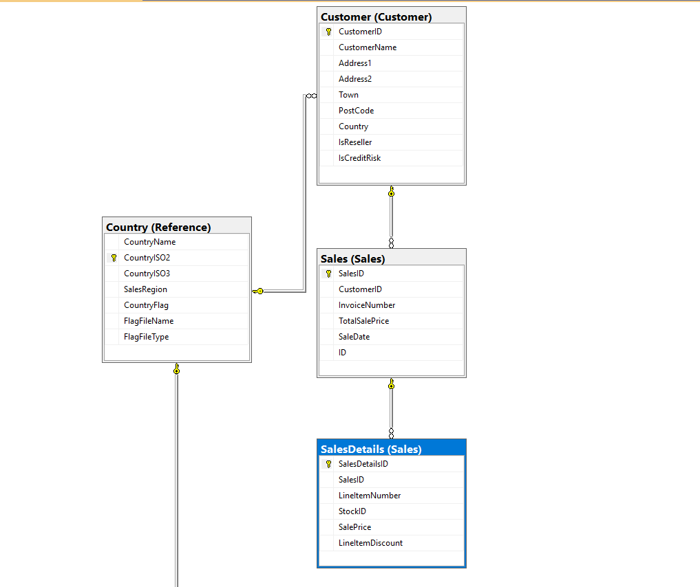
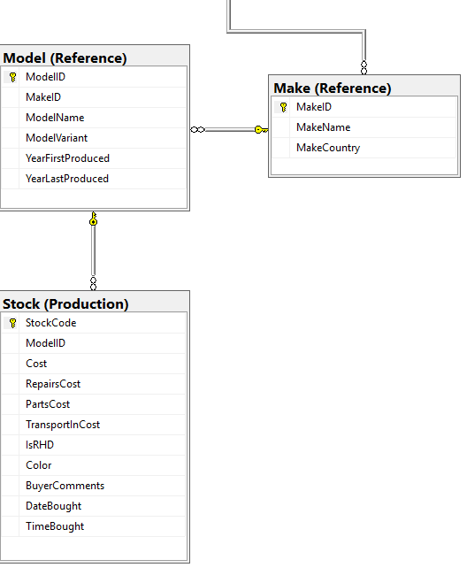
This diagram was generated directly using SQL Server Management Studio (SSMS) for the PrestigeCars database after all schema migrations, UDT conversions, NOT NULL/UNIQUE/CHECK constraints, and foreign keys were applied.
It shows:
Entities (tables): Country, Make, Model, Stock, Customer, Sales, SalesDetails
Attributes: Columns inside each table
Primary Keys (PK): Unique identifiers for each table
Foreign Keys (FK): Columns that create relationships between tables
Relationships:
  1 Country → Many Makes
  1 Make → Many Models
  1 Model → Many Stock items
  1 Customer → Many Sales
  1 Sale → Many SalesDetails
  Stock items link to SalesDetails via StockID
Data Flow:
The diagram visualizes how customer purchases, car inventory, and reference data all connect logically across schemas.

Slide 20
Conclusion
A dealership or company using this database can now easily track car inventory, monitor customer sales, and maintain accurate records without worrying about duplicated data, missing values, or invalid entries.
.

Slide 21
Resources we used
Besides the sources used for project 1, the lecture recordings and the videos provided by the professor , we listened to these sources to get a better understanding:
SQL Server ALTER SCHEMA Statement
ALTER SCHEMA in SQL Server - GeeksforGeeks
Unique constraints and check constraints - SQL Server |Microsoft Learn
Refactoring Databases: The Process - Simple Talk
.

